Slide 1
AIAA 5047 Responsible AI 2025 Fall
Sihong Xie, AI Thrust, Information Hub
Lecture 2
W2 201, 9-11:50 AM F

Slide 2
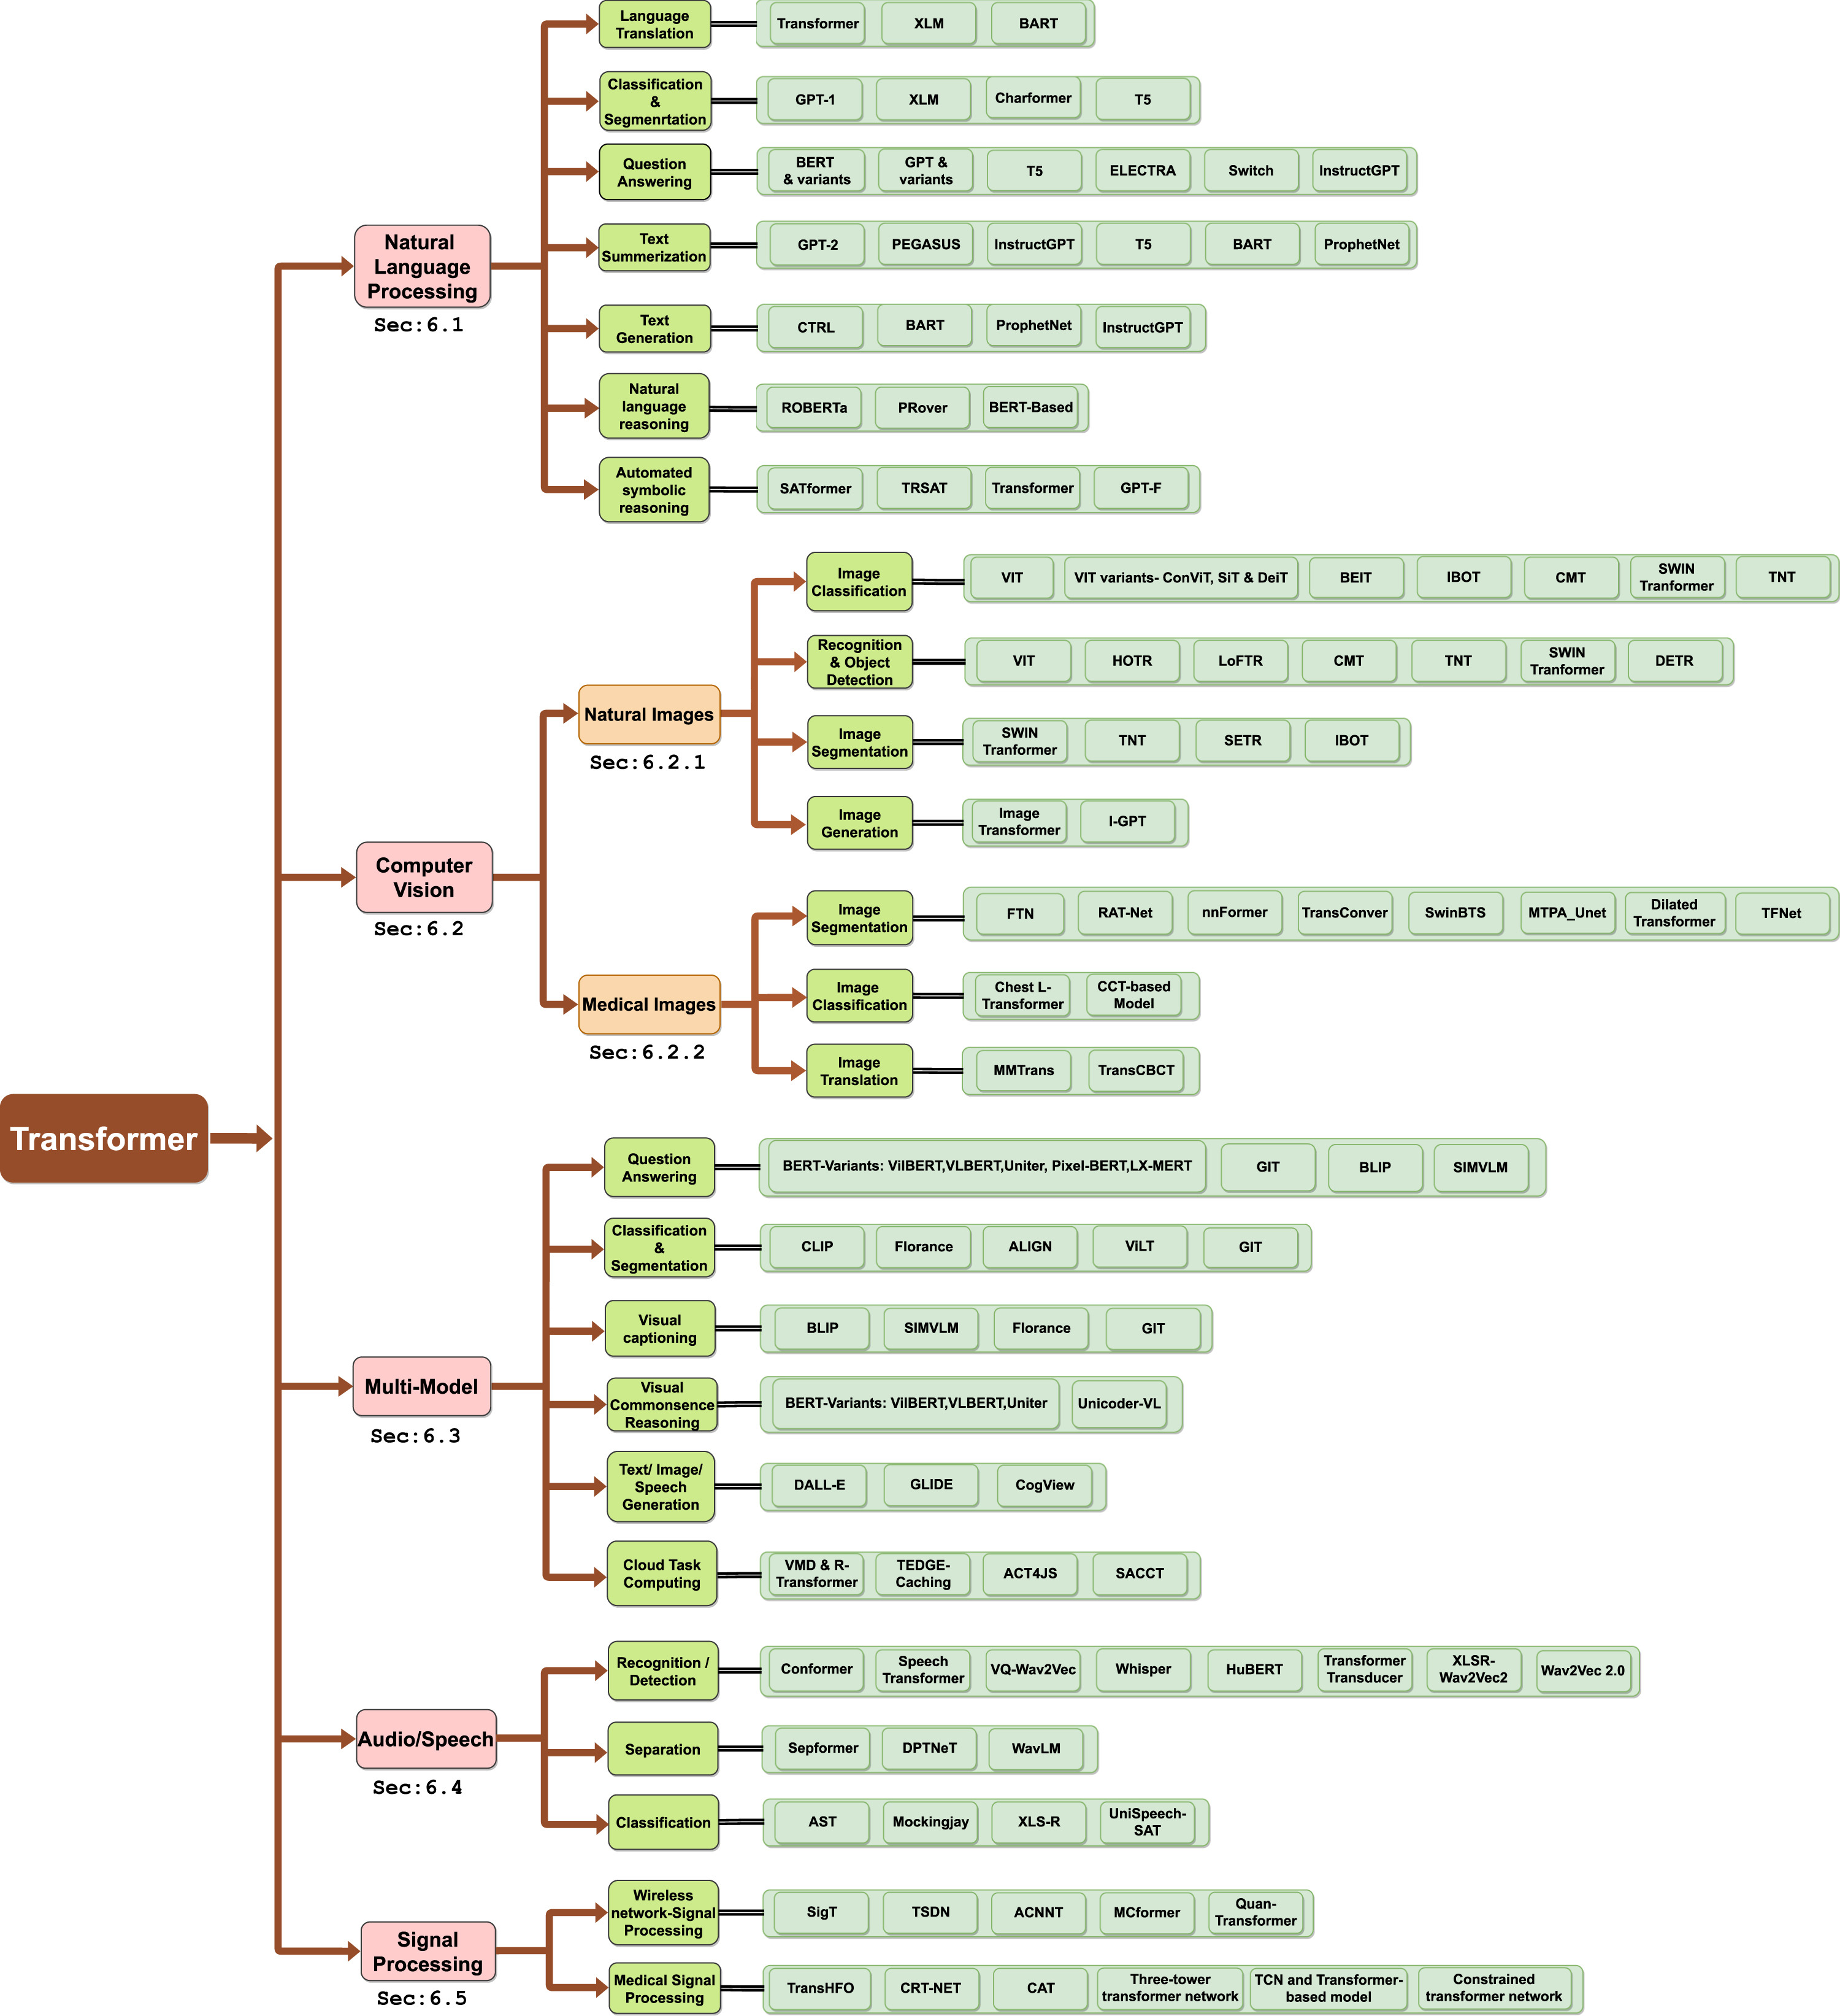
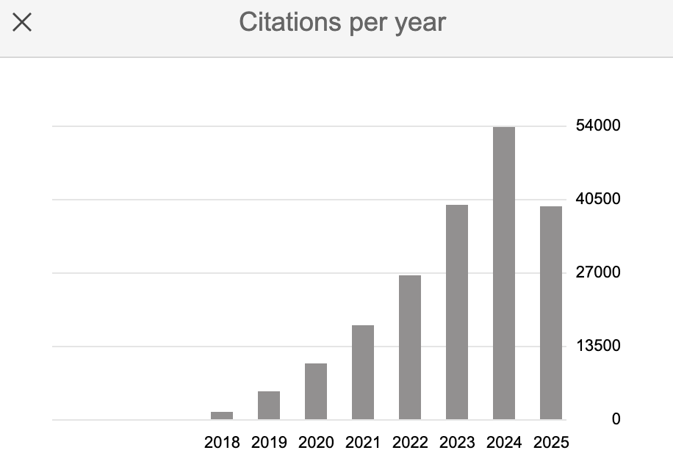
Introduction to Transformer
Started from the 2017 paper “Attention is all you need”.
Extended to computer vision and robotics and data science.
The current popular GPT-like applications are based on Transformer.
Image Source:
A comprehensive survey on applications of transformers for deep learning tasks.
Saidul Islam, etc. 2024

Slide 3
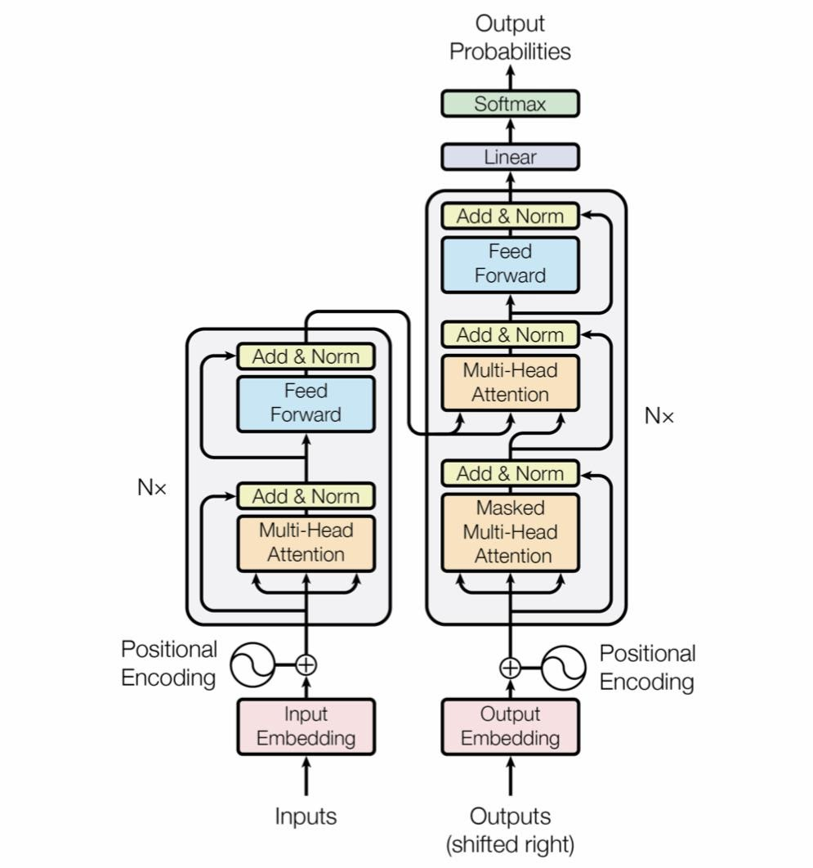
Transformer
As a foundation model, it needs
To be a large model to model general and diverse linguistic patterns (transformer-based to unification).
Consume large data to see all patterns （less inductive bias).
A breakdown of the transformer
Positional embedding
Feed Forward (MLP)
Masked Multi-head Attention
Residual connections
Layer normalization
More expressiveness
Easier to train large models
Initially: encoder-decoder arch
Later: decoder-only arch
Image Source:
Vaswani, Ashish, et al. "Attention is all you need." NIPS (2017).

Slide 4
Transformer
Positional embedding
To give a positional identification to a token.
The position of a token is important in deriving languistic features.
But they are different:
Syntactically: the first “trust” is subject, while the second is a object.
Semantically: the first “trust” the thing that creates something, while the second is the thing being created.
Another example
Tokenization
Trust is what builds trust
{trust, trust, is, what, builds}
embedding("trust")=embedding("trust")
A man bites a dog
Tokenization
vs.
{a, man bites, dog}
A dog bites a man

Slide 5
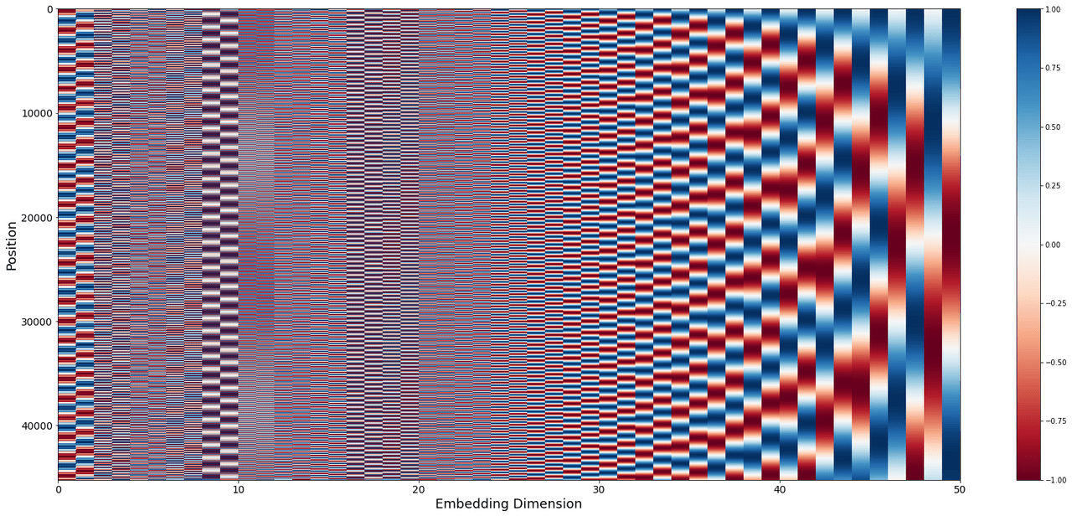
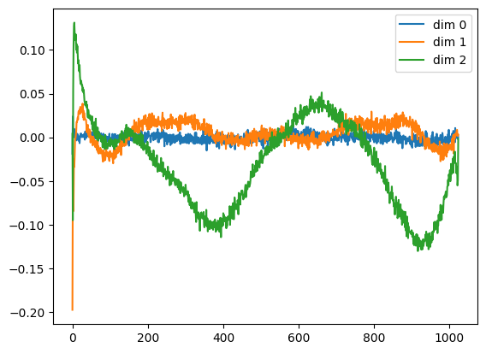
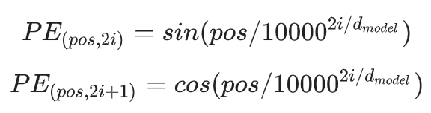
Transformer
Positional embedding
Positional encoding (fixed)
Trust is what builds trust
embedding("trust") + position_vector(0)
!=
0 1 2 3 4
embedding("trust") + position_vector(4)
Learnable positional embedding
wpe = nn.Embedding(config.block_size, config.n_embd)
Image Source:
Understanding Positional Encoding in Transformers — Blog by Kemal Erdem

Slide 6
Transformer
MLP Feed Forward Layer
MLP first maps x to higher dimensional space, then takes the GeLU nonlinear mapping, and finally projects back to dim(x).
Why it is necessary?
The self-attention layer can only find linear combination of value vectors.
What if some non-linearity is needed.
dim(x)
”dessert”=[1,1]
Proj
x₂
=
“pie”
=[0,1]
Convex hull of x₁ and x₂
GeLU
dim(x) * 4
FC
x₁=”apple”=[1,0]
dim(x)

Slide 7
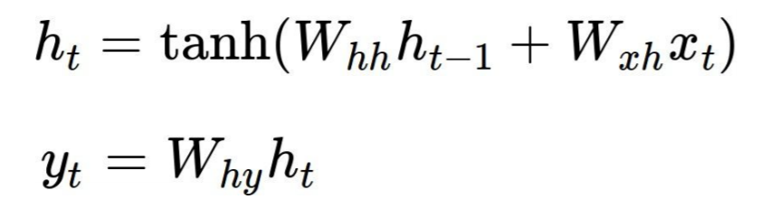

Transformer
The central of Transformer: attention mechanism
To address the gradient propagation issues of RNN/LSTM.
Why it is hard to learn the dependency?
If the model makes a wrong prediction “English” at the end, it is possible that the training data have more frequent “fluent English” occurrences (short-range dep).
The model forward passes are more influenced by the recent word such as “fluent”, while the far-away word “France” has its semantic vector modified by all the other words in the middle and the many multiplication of the weight matrix of RNN.
"I grew up in France, where I spent many years surrounded by my family and friends, so I speak fluent French."
Long-range dependencies
rollout
Notes:
h_t=\textnormal{tanh}(W_{hh} \textnormal{tanh}(W_{hh} h_{t-2}+w_{xh}x_{t-2})+w_{xh}x_{t-1})

Slide 8
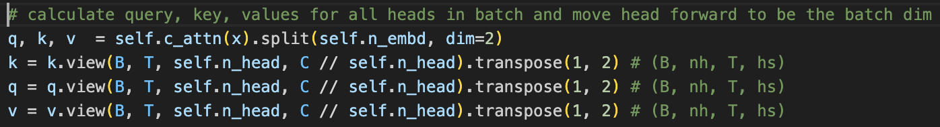
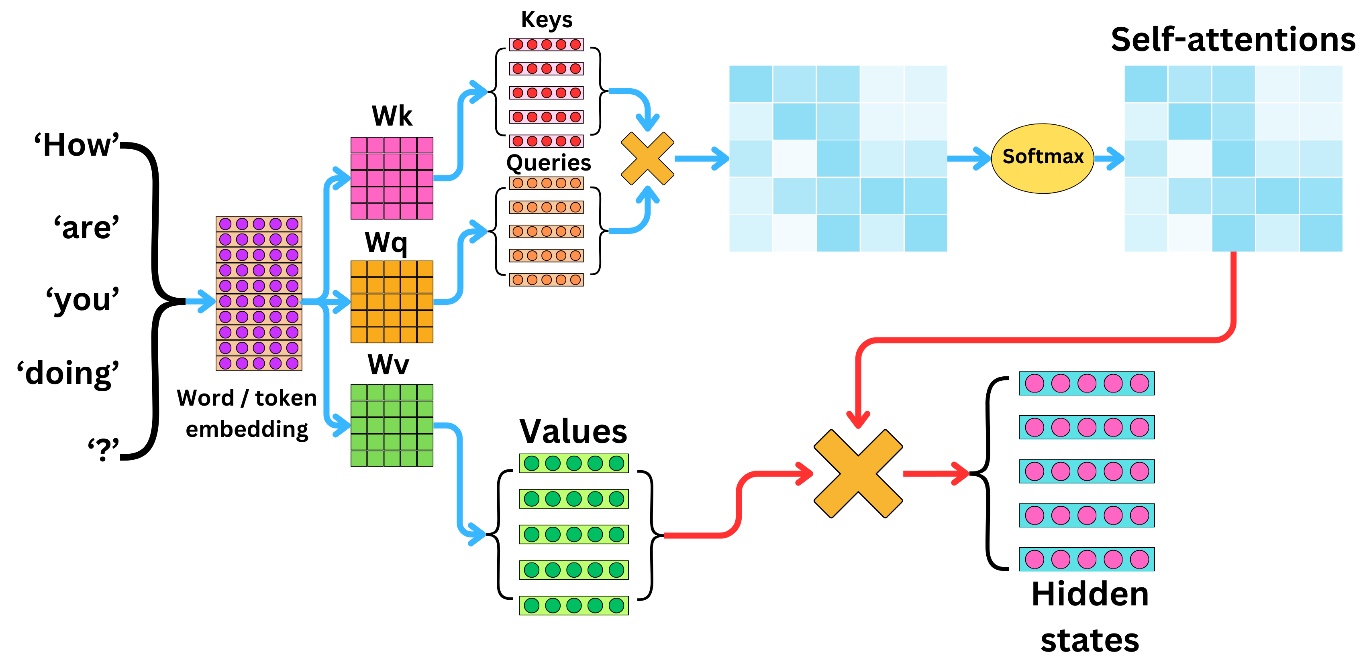
Transformer
self.c_attn=[Wk, Wq, Wv], shape=(n_embd, 3*n_embd)
C = nh * hs=n_embd
k.shape[B, T, nh * hs]
view
k.shape[B, T, nh, hs]
transpose
k.shape[B, nh, T, hs]
x.shape=[Batch_size, Token_len, n_embd]
Image Source:
TheAiEdge.io

Slide 9
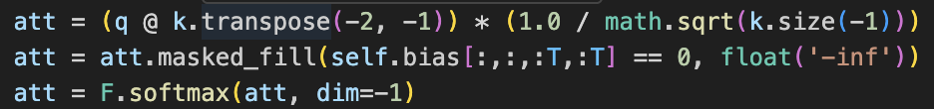
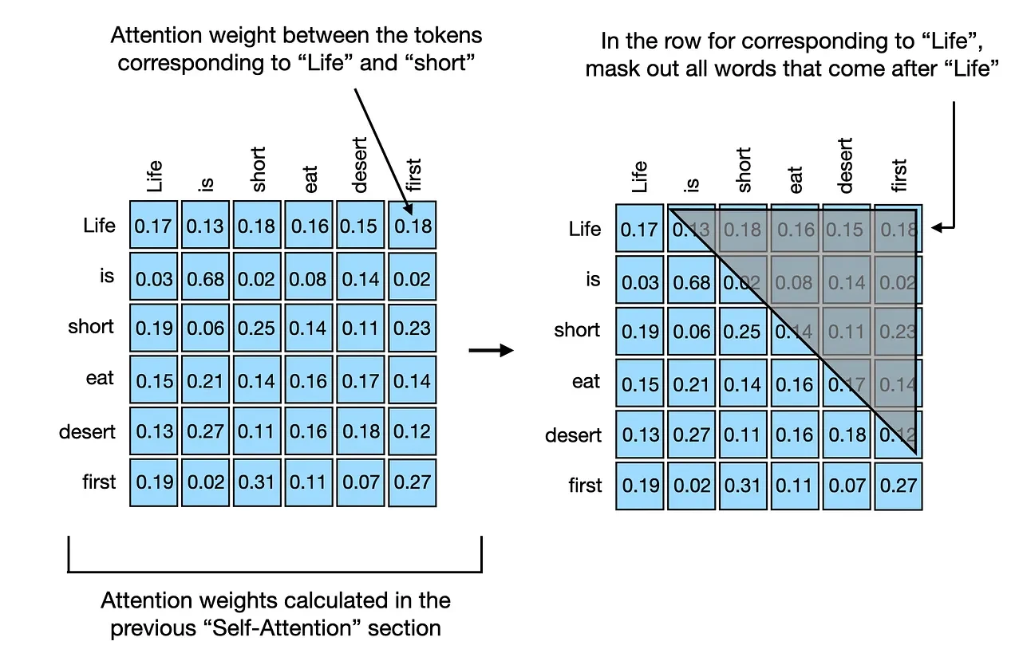
Transformer
To prevent the inner products
from inflating the scales.
q.shape=[B, nh, T, hs]
k.transpose(-2,-1).shape=[B, nh, hs, T]
(q @ k).shape=[B, nh, T, T]
self.bias[:,:,:T,:T] has the upper triangle = 0
Causal Attention: don’t look into the future
>>> import torch
>>> a=torch.tensor([1,2,3,float('-inf'), float('-inf'), float('-inf')])
>>> F.softmax(a)
tensor([0.0900, 0.2447, 0.6652, 0.0000, 0.0000, 0.0000])
Image Source:
https://magazine.sebastianraschka.com/p/understanding-and-coding-self-attention

Slide 10


Transformer
att.shape=[B, nh, T, T]
v.shape=[B, nh, T, hs]
(att @ v).shape=[B, nh, T, hs]
[B, T, hs]
[B, T, nh * hs]=[B, T, C]
[B, T, hs]
[B, T, hs]

Slide 11
Transformer
Residual connections
x=MSA(x)+x and x=MLP(x)+x
Intuitions:
At any layer, if a mapping is unnecessary for a token, just let that mapping to be zero and push the input to the next layer.
Mapping from [9, 11, 19, 21] to [10, 12, 18, 20] is hard, but from [9, 11, 19, 21] to the residual [-1,-1,1,1] is much easier.
Why it is necessary?
Allow information to directly forward to the next level without MSA or MLP (which are just learned to be the zero mapping).
Allow gradients (of loss function of supervision) to directly backprop to the earlier layers, without too many multiplications and eventual gradient explosion or vanishing.

Slide 12
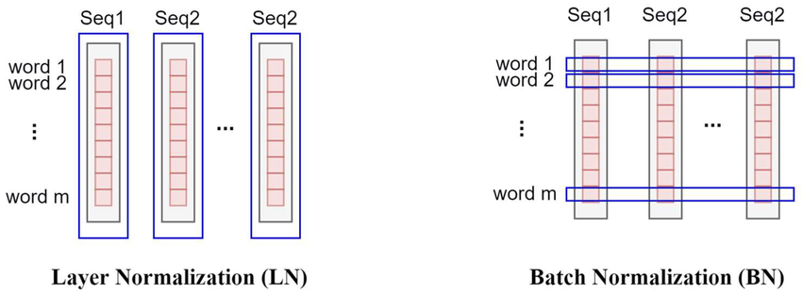
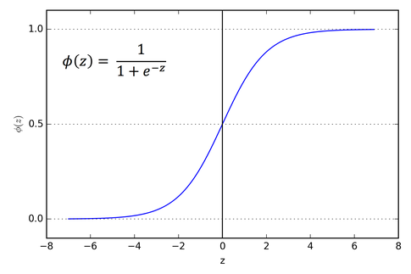
Transformer
Layer normalization
Intuitions:
For all neurons at the same layer, the “scale” of their activations should remain about the same as the input.
After going through many layers, the scale of activations should remain about the same.
Why it is necessary?
If several layers enlarge or shrink the activation scales dramatically, there is the so-called “saturation of softmax” and consequently the “vanishing gradient” issue.
>>> a=torch.tensor([1.,2.,3.])
>>> b=torch.tensor([10.,20.,30.])
>>> softmax(a)
tensor([0.0900, 0.2447, 0.6652])
>>> softmax(b)
tensor([2.0611e-09, 4.5398e-05, 9.9995e-01])

Slide 13
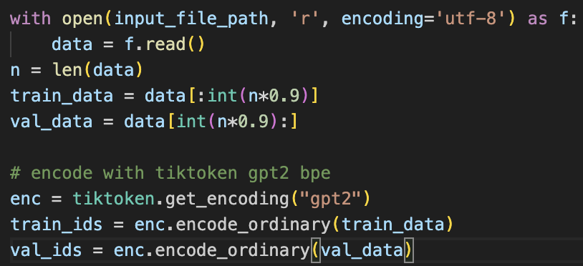
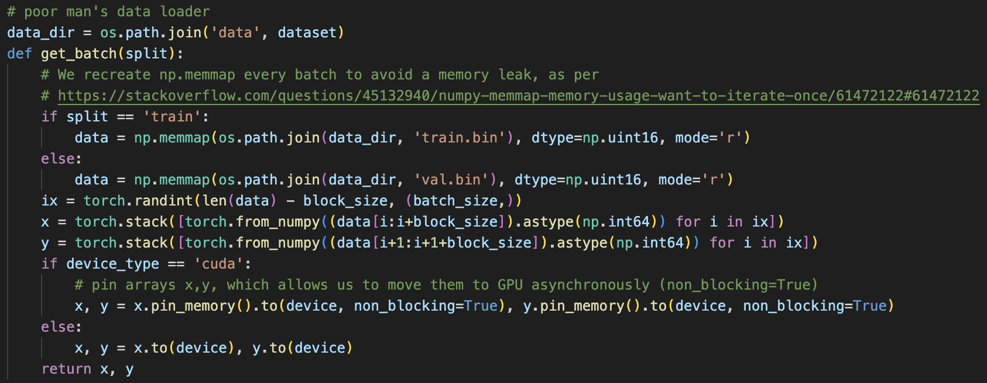
Transformer
Training
Prepare training and validation data
Load raw texts.
Use an existing encoder to turn text token into indices.
Save to binary files.
Sample a batch: randomly
Load part (not all) of the file to memory.
batch_size=4
block_size
y₁
y₂
y₃
y₄
x₁
x₂
x₃
x₄
i=1
i=2
i=3
i=4
Total tokens

Slide 14
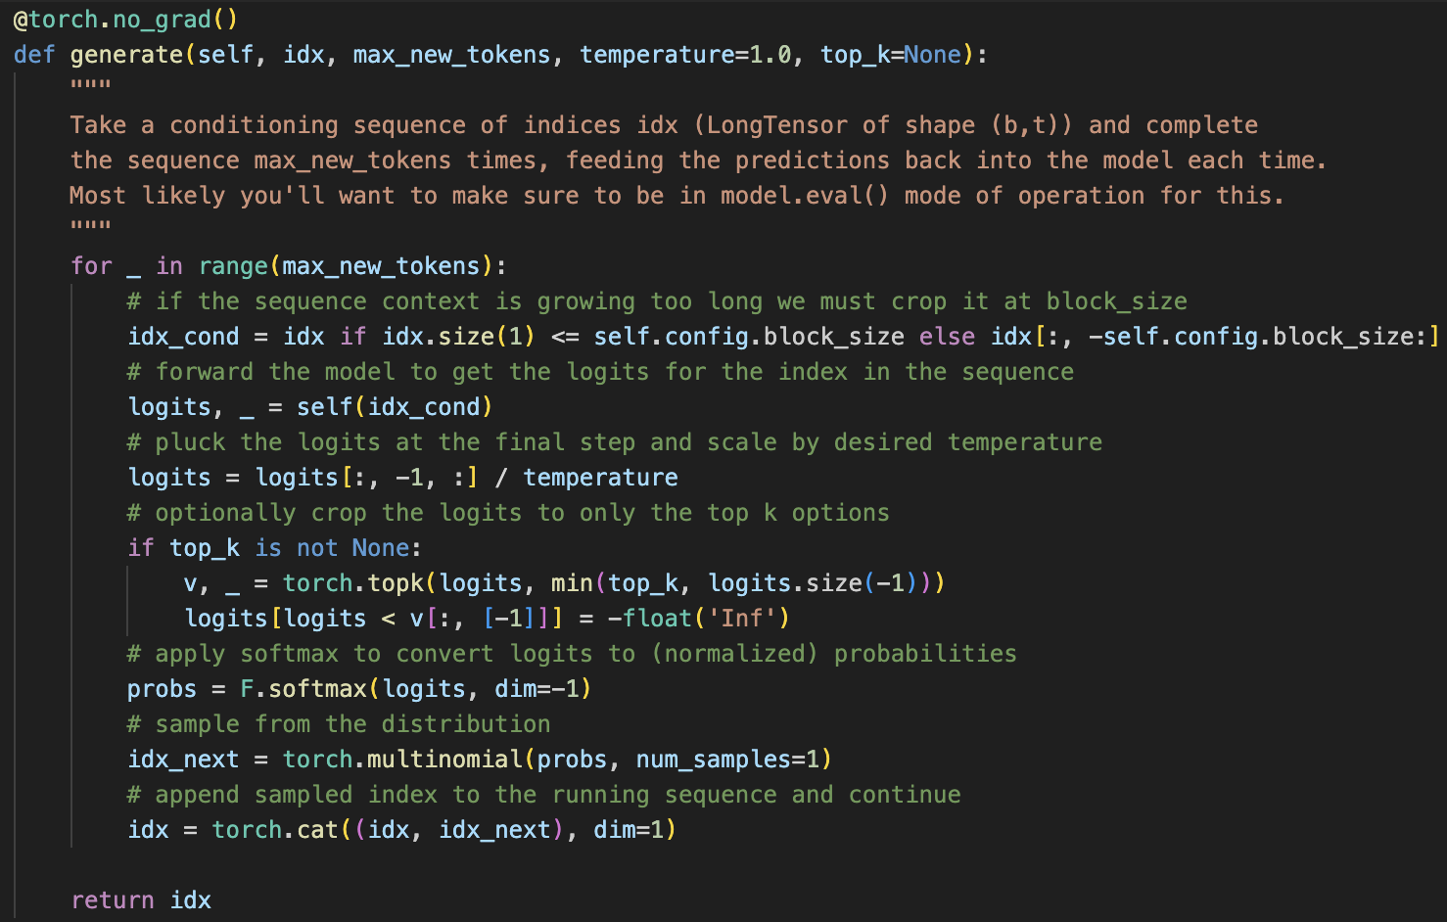
Transformer
Inference
idx_cond.shape =[batch_size, block_size]
Take the final row
Transformer
logits.shape =[batch_size, voc_size]
Find top-k per row
Sample probs
idx_next.shape=batch_size

Slide 15
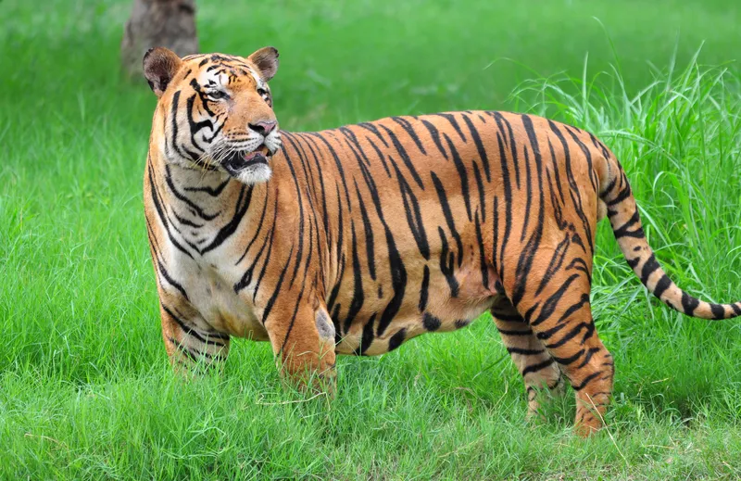
ViT: vision Transformer
Motivations
CNN has difficulty in modeling long-range dependencies on images well.
The concept of head consists of local parts.
Convolutional kernel (window)
Query: “Does the tiger have both head and tail?”
To answer this, need to gather information from both head and tail areas.
The horizontal distance the head and tail = 800 pixels
Window size = 40 x 40 pixels
With a stride length=1 pixel and without pooling, it takes
(800-1)/(40-1)=20 layers of convolution to connect the head and tail. (how to calculate this: imagine a 1D array of length 800, each 1D kernel reaches to the farthest neuron in its receptive field to extend its receptive field of size (40-1)).
Deeper networks are harder to optimization smoothly, due to gradient explosion or vanishing. Many techniques, such as normalization, residual connection and dropout, are invented to make the CNN deeper, but the problem is not solved.
Translation won’t change the answer
Can we give up CNN architecture? Can the success of transformer in NLP be transferred to computer vision?
There is a risks of needing more data as the inductive bias, locality and translational invariance, will be dropped.

Slide 16
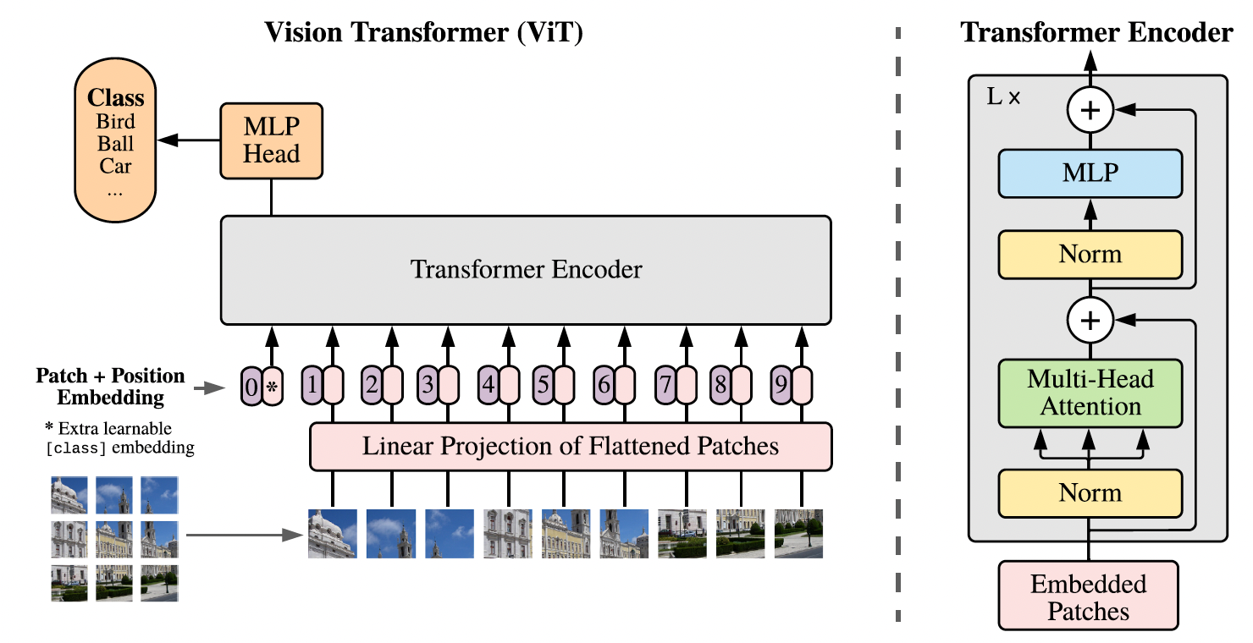
ViT: vision Transformer
Take the idea of Transformer to computer vision
Not the first work using attention mechanism on images^{[1,2]}.
Not the first work using a purely transformer architecture^{[3]}.
The first to train pure transformer on large-scale image datasets.
Make a HxWxC image into Nx(PxP)xC patches
Position embedding is important for image understanding (man in car vs. man by car)
Since the first layer, a patch can reach to any other patch through Multi-Head Self-Attention, thereby capturing long-range dependencies.
Image classification with a [CLS] token.
[1] Xiaolong Wang, etc.. Non-local neural networks. CVPR, 2018.
[2] Nicolas Carion, etc.. End-to-end object detection with transformers. ECCV, 2020.
[3] Prajit Ramachandran, etc. Stand-alone self-attention in vision models. NeurIPS, 2019.
Image Source:
An image is worth 16x16 words: Transformers for image recognition at scale. Dosovitskiy, Alexey. ICLR 2021

Slide 17
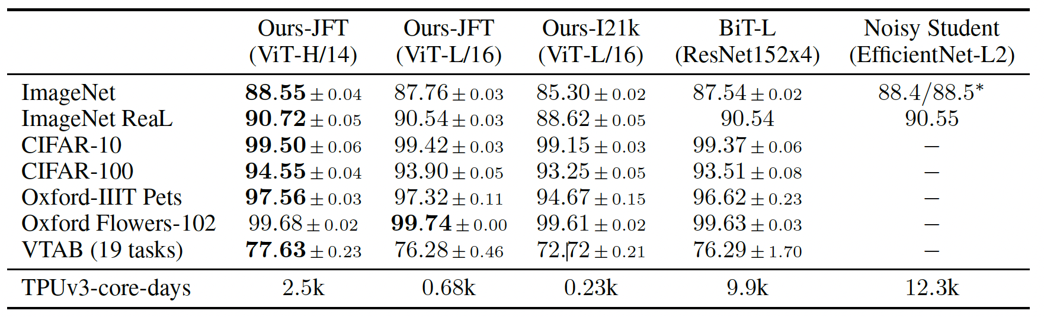
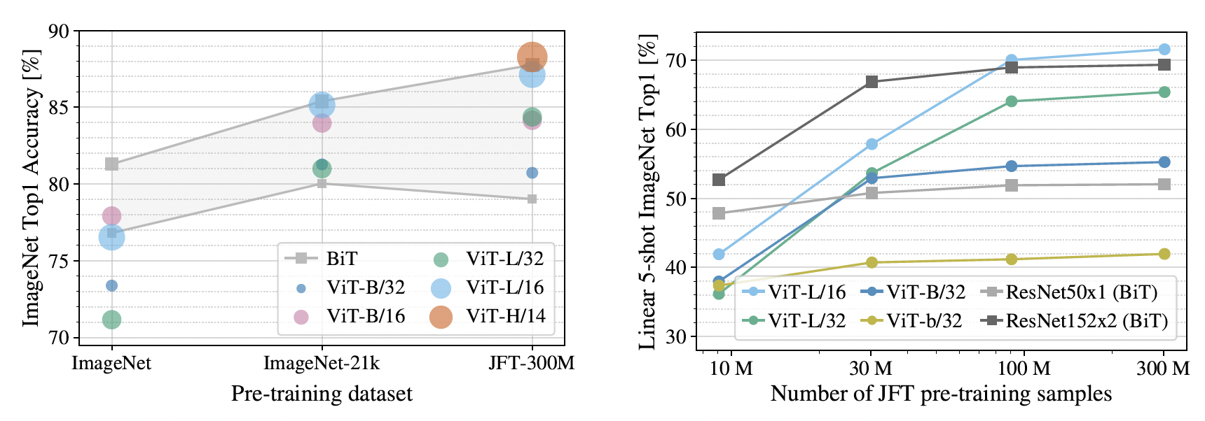
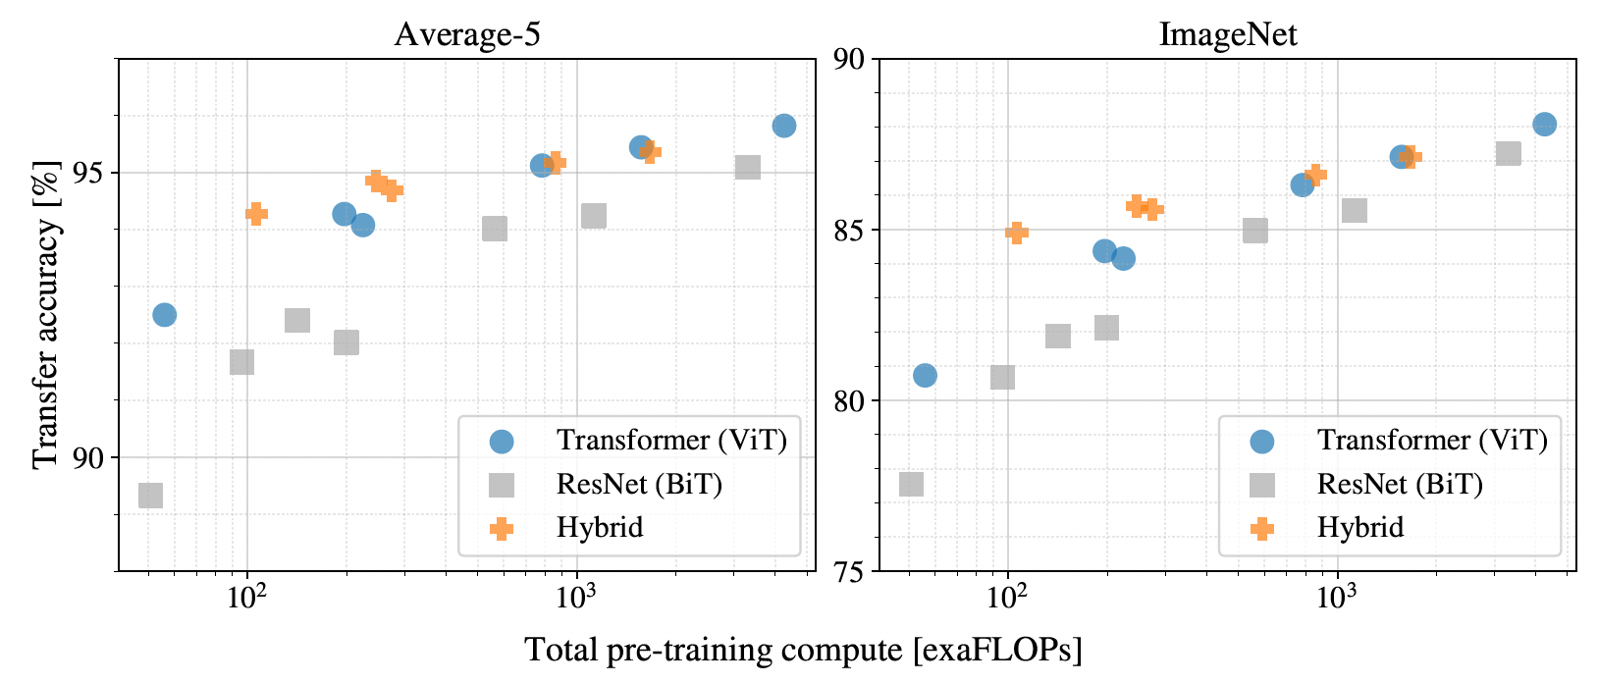
ViT: vision Transformer
Bigger model
More data
ResNet
Test data
Less computation
Scaling law in CV:
With enough data, inductive bias can
be dropped.
Image Source:
An image is worth 16x16 words: Transformers for image recognition at scale. Dosovitskiy, Alexey. ICLR 2021
With a medium-size image dataset (ImageNet), not as good as ResNet.
With a much larger dataset (Google JFM-300M), beats SOTA

Slide 18
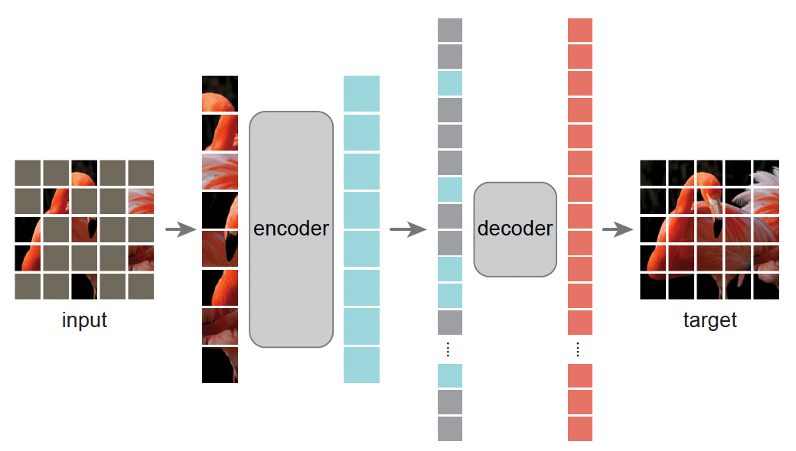
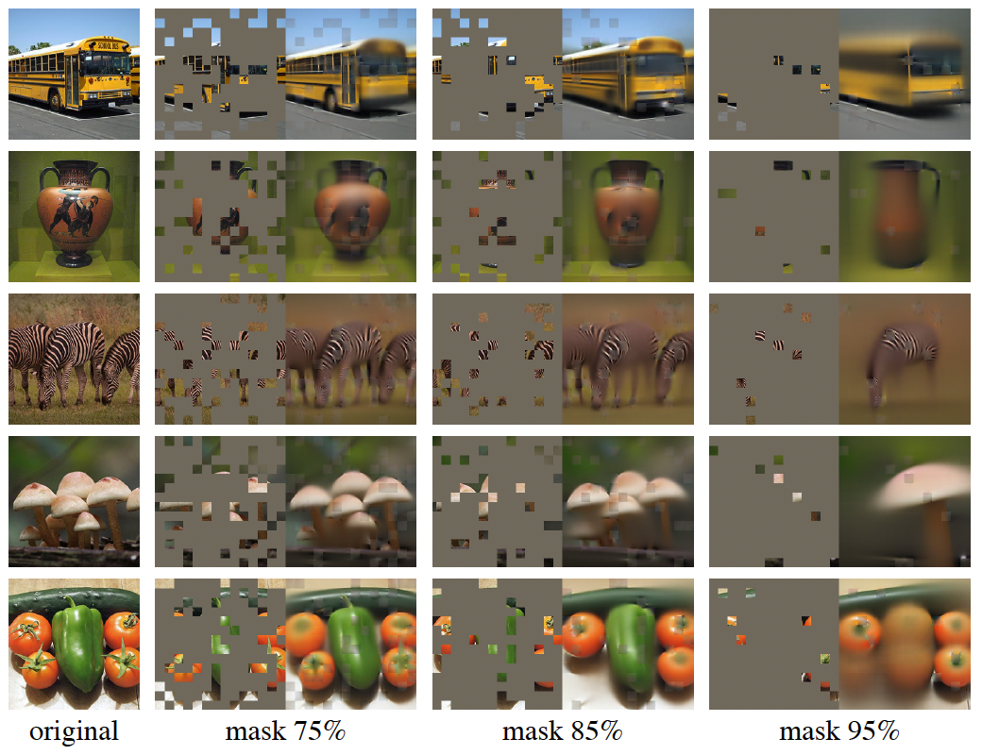
ViT variants: MAE self-supervised pre-training
Motivation
Can self-supervision works for pre-training ViT?
Autoregressive or masked autoencoding are successful for GPT and BERT, resp.
Image vs. Languages
Each word has higher information density than a missing image patch.
Decoder of image needs to predict many pixels and thus more critical.
Solution
Very high % of masked patches: increase information density and reduce redundancy.
MSE loss over the masked pixels
Image Source:
Masked Autoencoders Are Scalable Vision Learners. He, Kaiming, et al. CVPR 2022

Slide 19
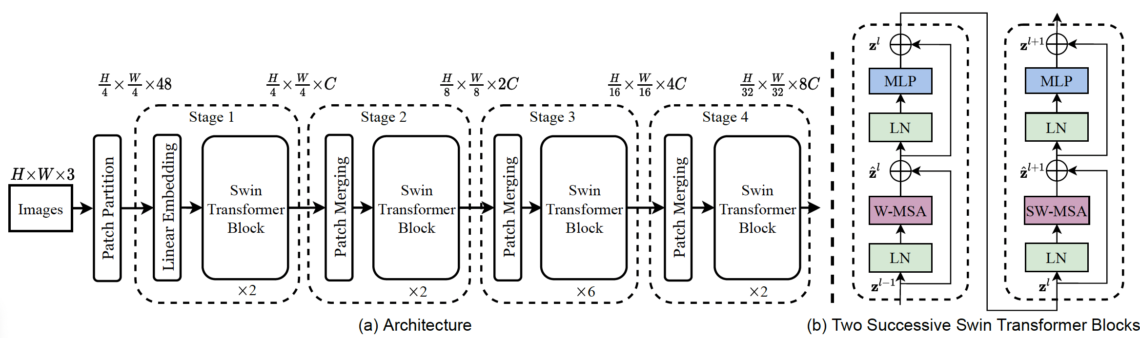
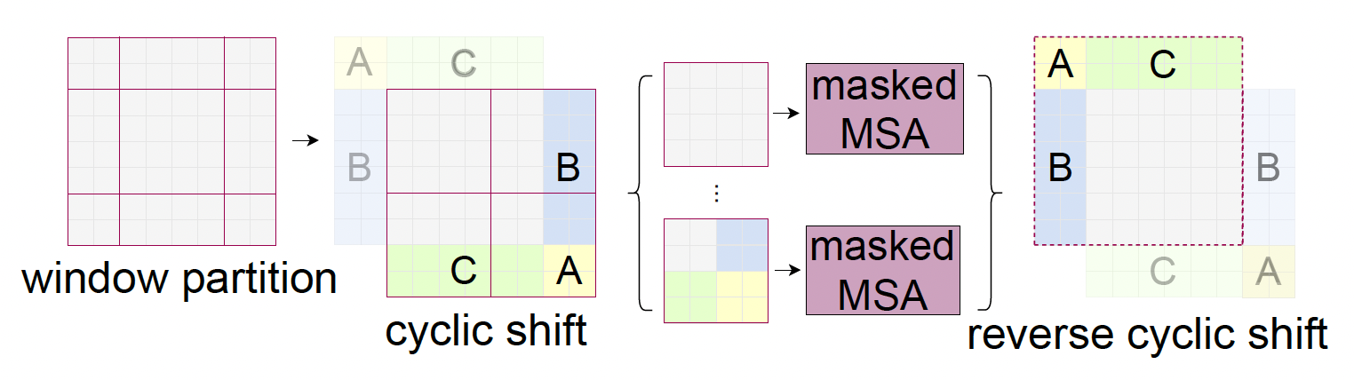
ViT variants: Swin Transformer
Motivations
ViT uses a fixed patch size, and cannot be adapted to different object size.
What if the boundary of a patch cuts on an object?
Solution
Let the patch size varies across layers: as small as 2x2 and as large as 32x32.
Can detect small and large objects
Can make object segmentation.
Let the patches shift around the image: able to cover one object in a single patch
Image Source:
Swin Transformer: Hierarchical Vision Transformer using Shifted Windows . Liu, Ze, et al. ICCV 2021

Slide 20
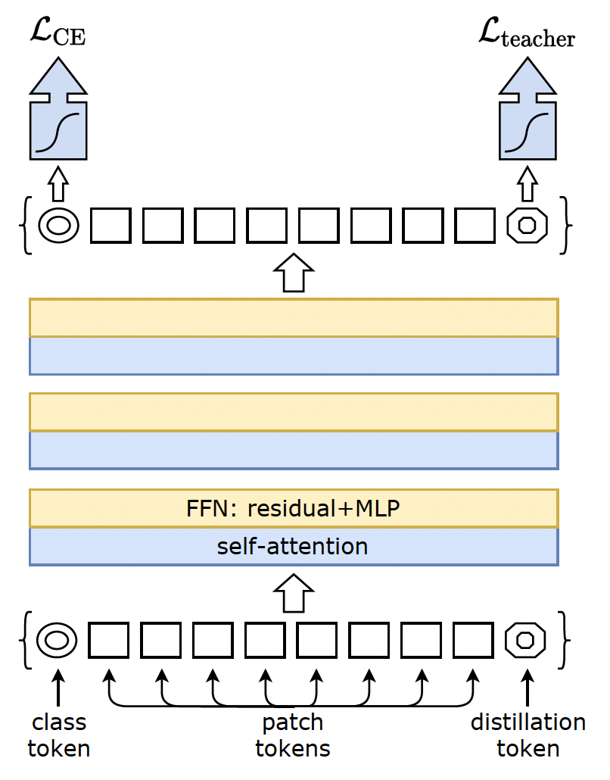
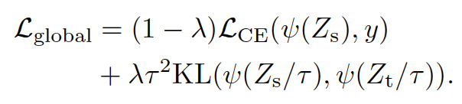
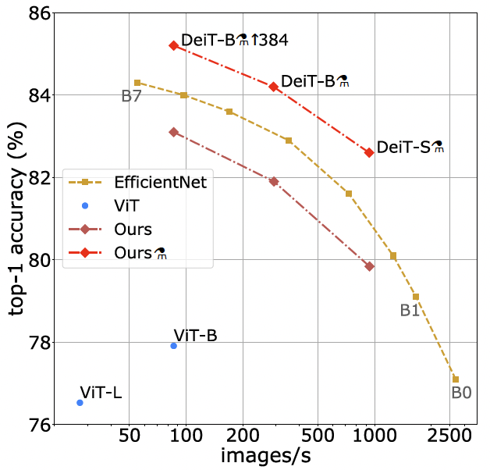
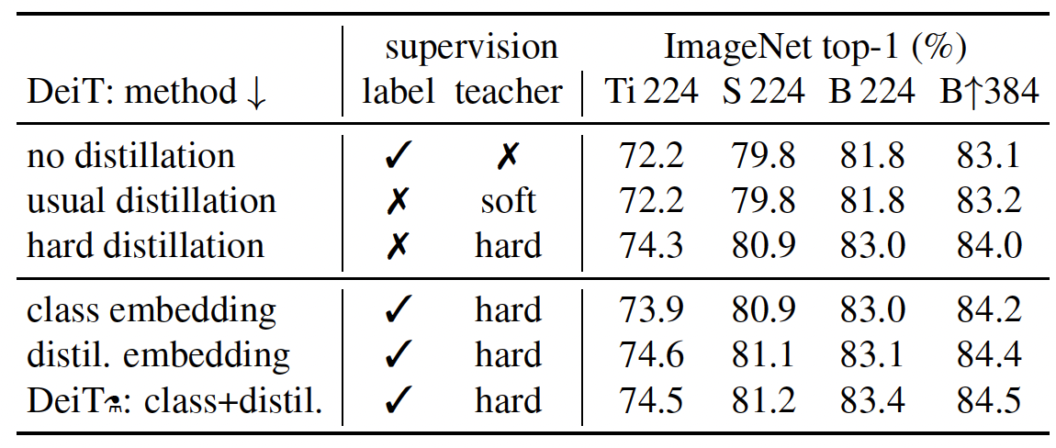
ViT variants: DeiT
Motivations
ViT uses 300m private labeled image for training and its model size is large.
Can we use only ImageNet-1k (publicly available) and cheaper GPU?
Solution
Same ViT architecture except additional distillation token and loss function.
To mimic a teacher model which is a CNN model (maybe the inductive bias therein).
Image Source:
Training data-efficient image transformers & distillation through attention. Touvron, Hugo, et al. ICML, 2021.

Slide 21
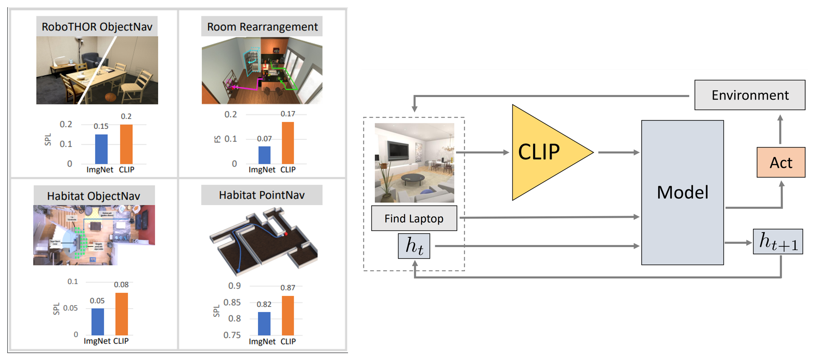
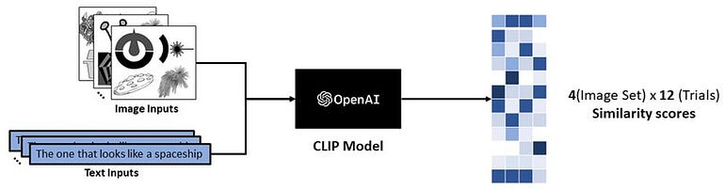
CLIP (Contrastive Language-Image Pre-training)
Motivation
ViT has one label per image. Utilize weaker supervision: (image, text) pairs; no segmentation mask or bounding box, no image class labels.
Understanding the correspondence between image and text modalities.
Allow open-world classification/recognition…
Applications: multi-modal QA, robotics (VLM and VLA).
Intuitions:
If we can pair an image with the correct describing texts, and a piece of text with the image that the text is describing, then the model may learn to relate the contents in the image to the keywords in the text.
Image Source: https://blog.lancedb.com/multi-modal-ai-made-easy-with-lancedb-clip-5aaf8801c939/ Simple but Effective: CLIP Embeddings for Embodied AI

Slide 22
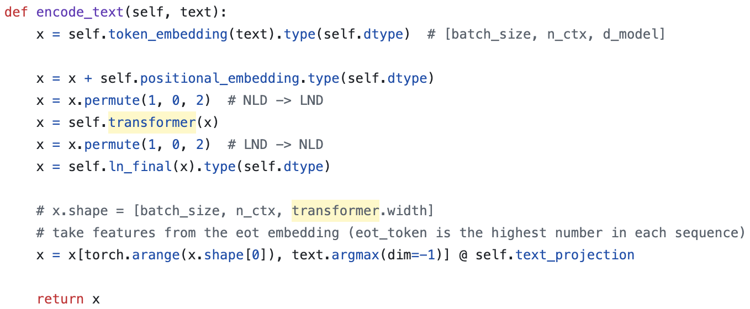
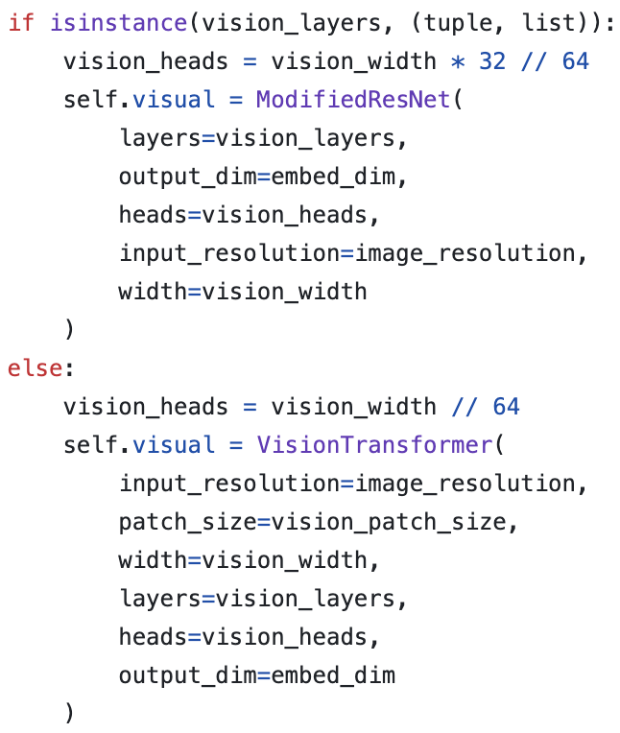
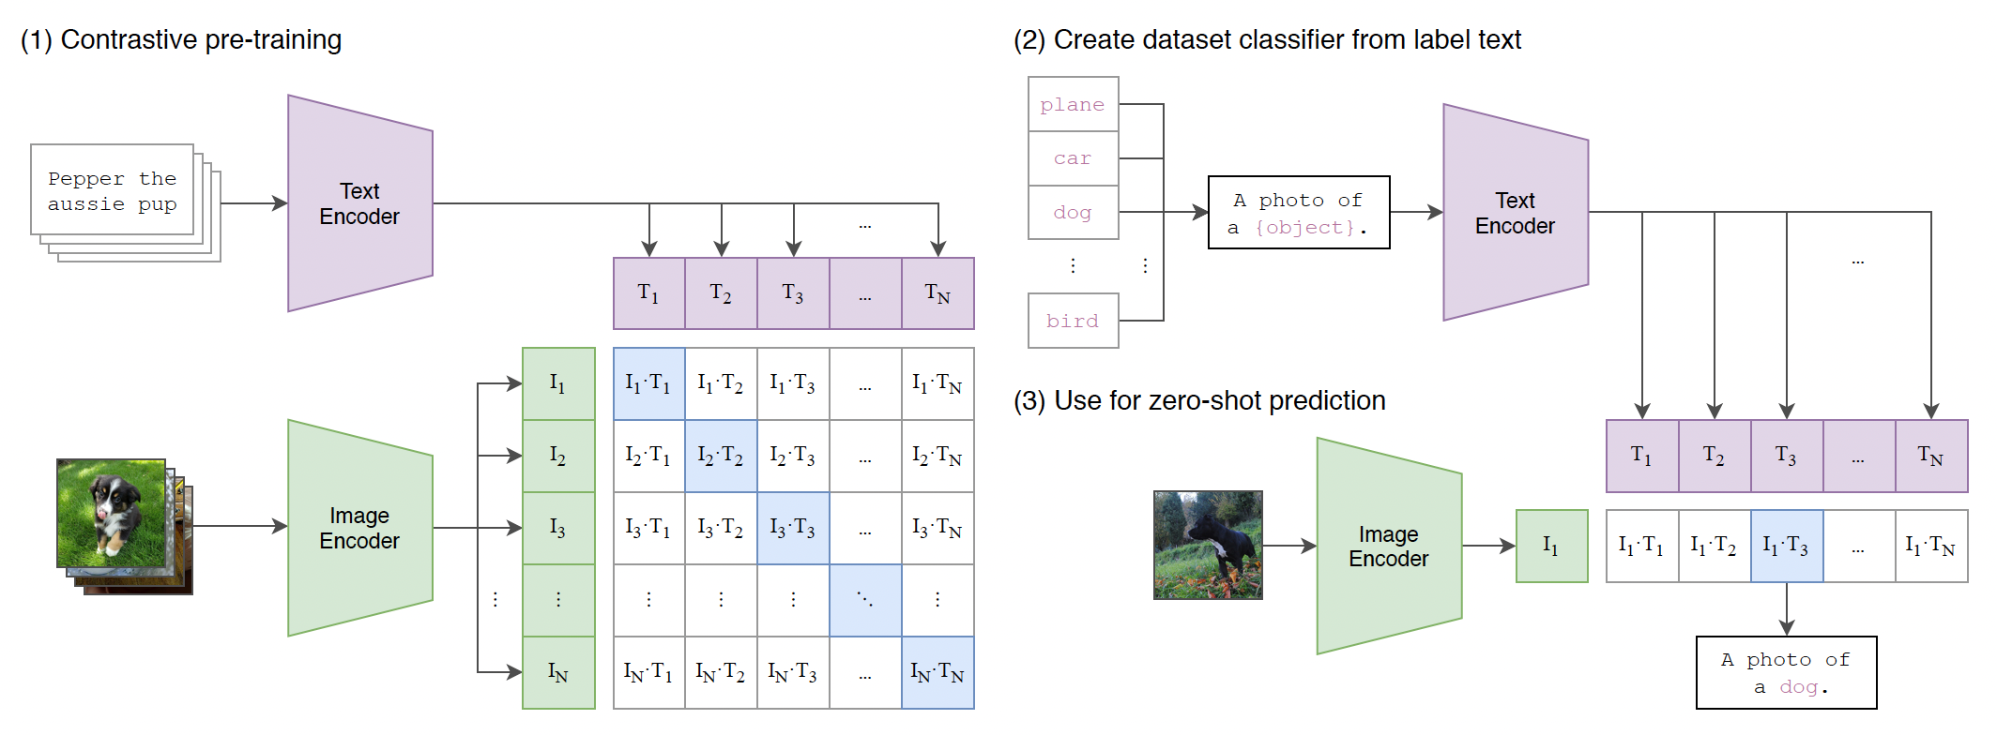
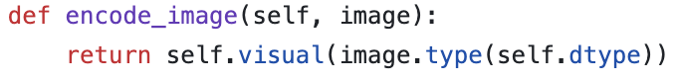
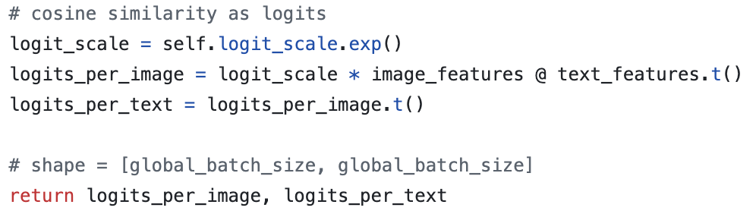
CLIP
ResNet-50 and -101
ViT-B/32, ViT-B/16, ViT-L/14
Prompt as a classifier
L_i2t = -log(exp(sim(i,t_i)/τ) / Σ_j exp(sim(i,t_j)/τ))
L_InfoNCE = (L_i2t + L_t2i) / 2
Image Source:
Learning transferable visual models from natural language supervision. Radford, Alec, et al. ICML, 2021.

Slide 23
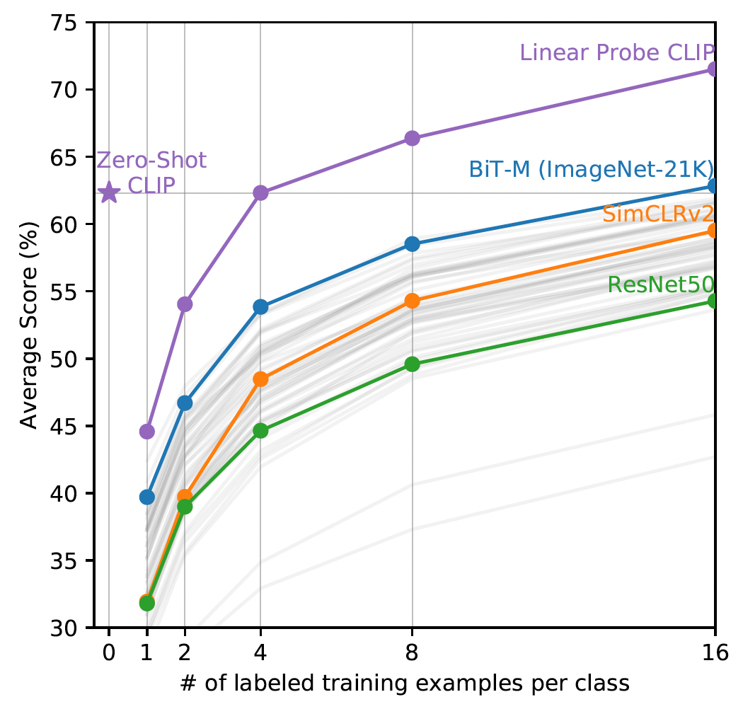
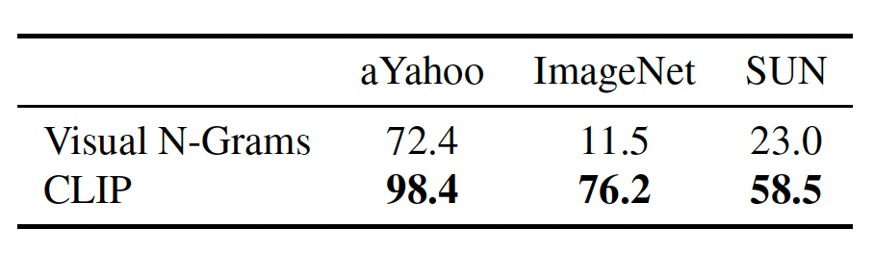
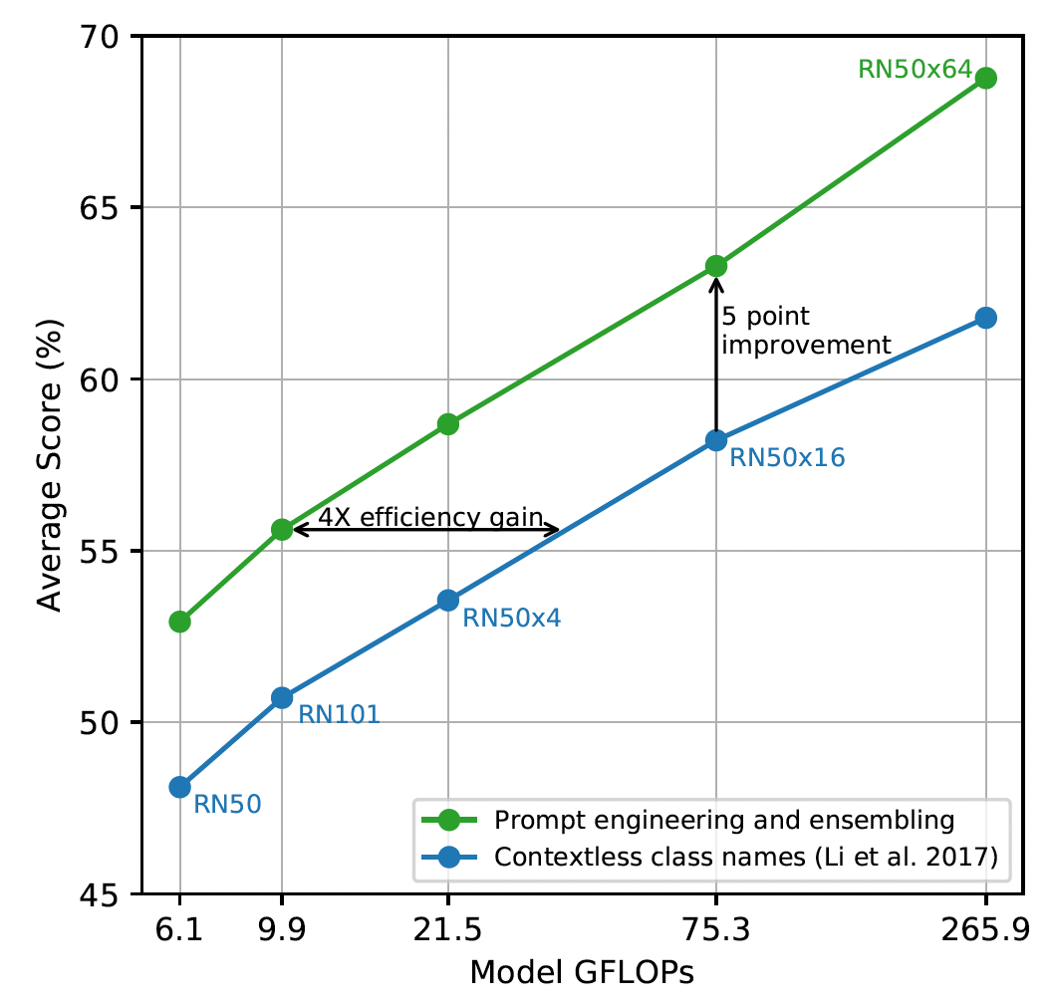
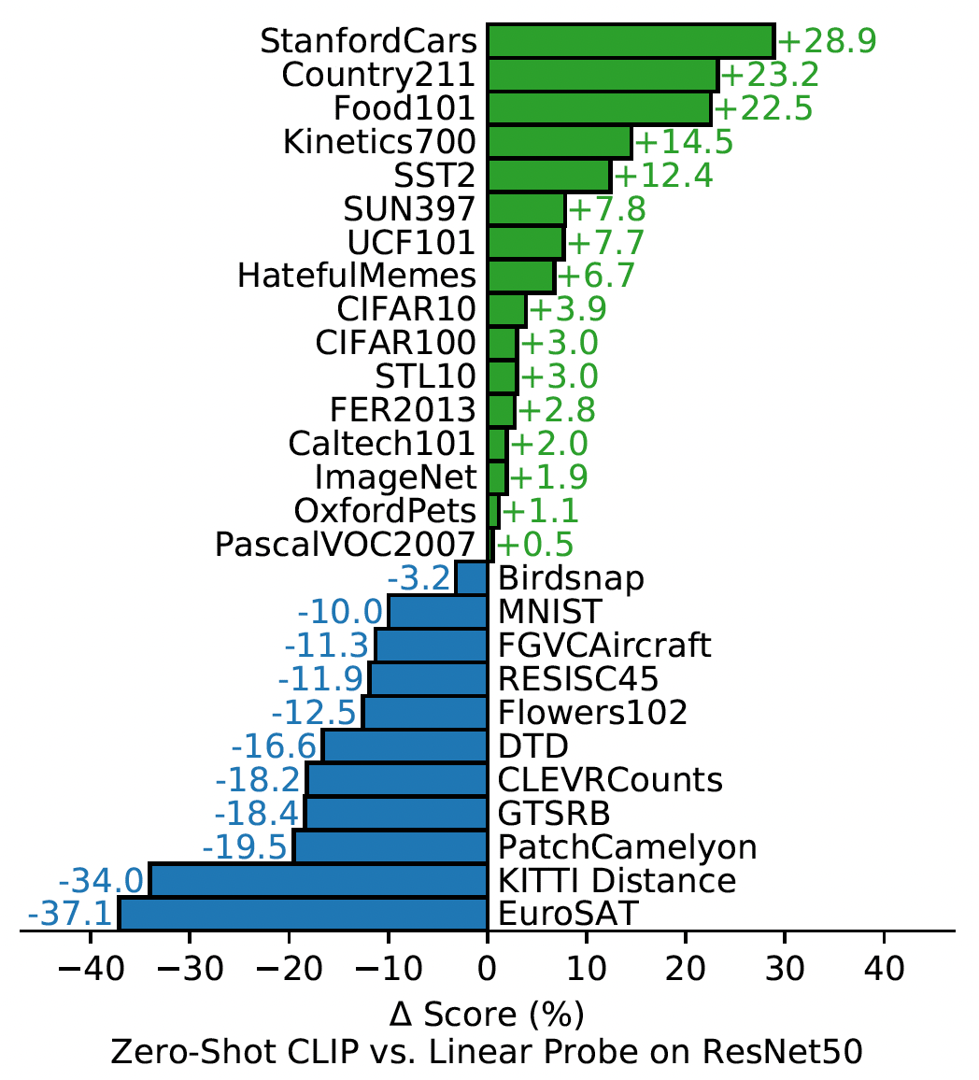
CLIP: zero-shot performance
Image classification datasets not used in pre-training
On average, zero-shot CLIP is comparable to ResNet50 trained on 21k labeled images.
The importance of prompt optimization: create prompts like “A photo of a big {label}” and “A photo of a small {label}” and ensemble the results of 80 such prompts.
Prompt optimization and ensembling
A breakdown of the average performance over the 27 test datasets.
Comparing image encoding with a single label word encoding
A similar work appears simultaneously with larger training set:
Scaling Up Visual and Vision-Language Representation Learning With Noisy Text Supervision. ICML 2021
Image Source:
Learning transferable visual models from natural language supervision. Radford, Alec, et al. ICML, 2021.

Slide 24
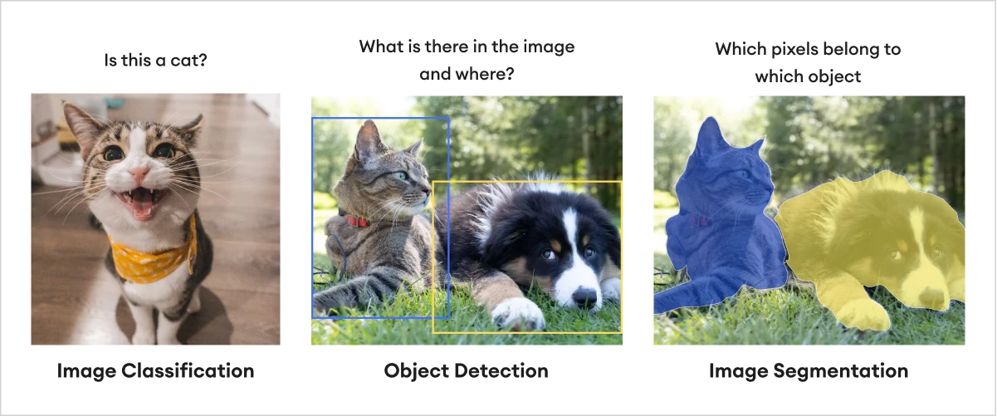
SAM: Segment Anything Model
Motivation
What is segmentation?
There is sharp conflict between “more data” and “labeling cost”.
Need a foundation model for image segmentation so that it can do zero-shot segmentation (rather than collecting many more masked images for each new class), or be quickly fine-tuned to special tasks (with only a small number of labeled data).
Segmentation is harder than image classification or object detection:
Higher complexity: more details on the pixel level, so that each pixel requires a label.
Ambiguity: what’s the boundary between the cat’s fur and the fuzzy grass?
High labeling cost: providing masks is time-consuming due to fine details, non-regular shapes, and ambiguity.
Image Source: https://wiki.camthink.ai/zh-Hans/docs/neoedge-ng4500-series/application-guide/object-detection/
Simple but Effective: CLIP Embeddings for Embodied AI

Slide 25
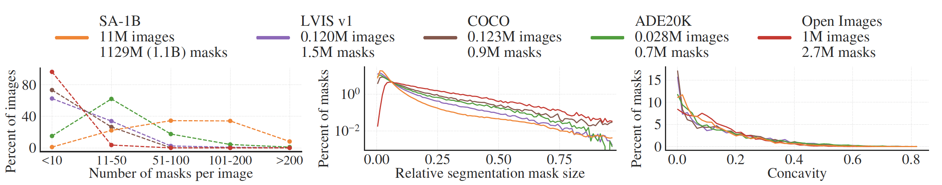
SAM: Segment Anything Model
First question: how to construct a large-scale segmentation mask dataset?
Before SAM, the largest one is OpenImage. SAM has 11x more images and 400x more masks.
Better to have an automatic tool to assist the labeling.
Bootstrapping:
Train initial SAM on public data
Stage 1: easy annotators click, SAM masks, annotator refine
<30 sec / image
Stage 2: less prominent obj. SAM masks, annotators label missed
Stage 3: fully automatic
Find only stable masks
ViT-B
Model re-trained 6 times
ViT-B to ViT-H
Model re-trained 5 times
Model fixed
The resulting SA-1B
dataset
Most images have more masks than others
Mask size and shape follow the others

Slide 26
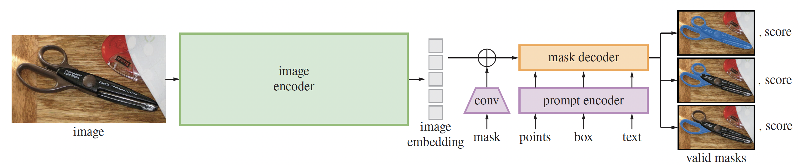
SAM: Segment Anything Model
Any one is a valid segmentation given a point prompt on the left-handle of the scisor
Architecture
Text prompt
ViT-B or ViT-H
pretrained using MAE^{[1]}
Run only once for an image
For many different prompts to reduce cost.
Text prompt=“a large tiger”
Box prompt
Point prompt
[1] Kaiming He, etc.. Masked autoencoders are scalable vision learners. CVPR, 2022.
Image Source:
Segment Anything. Kirillov, Alexander, et al. CVPR, 2021.

Slide 27
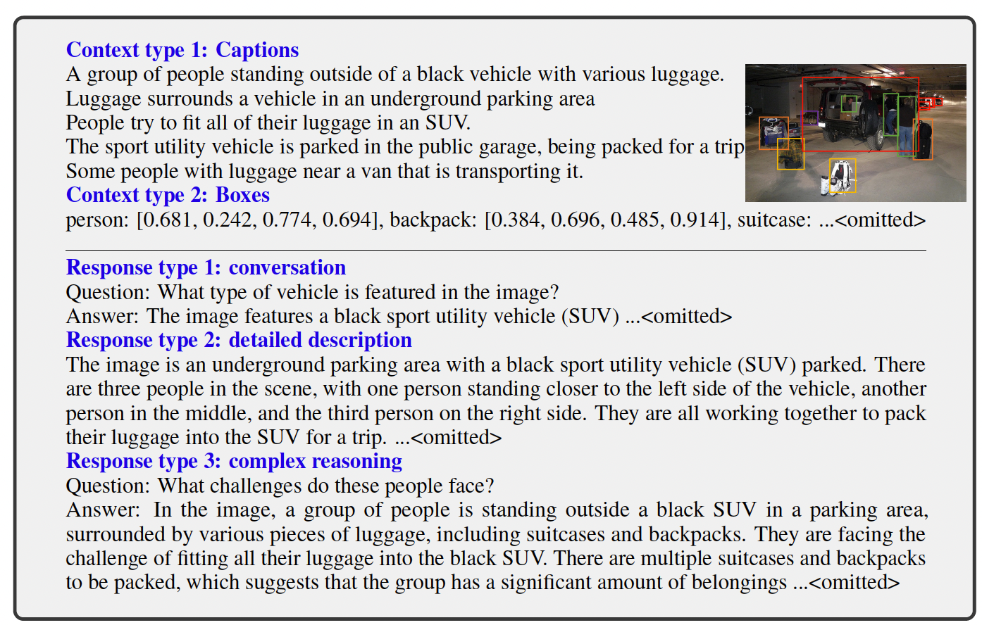
LLaVA: going beyond matching
Motivation
Multi-modal models are constrained to single tasks, such as image recognition, object detection, etc. [one for one]
On the other hand, LLM can do many things such as translation, summarization, reasoning, etc. [one for all]
How can we make multi-modal models to follow user instructions to conduct diverse kinds of tasks, including generative ones?
Contexts
Instructions
Responses
Visual Instruction Tuning. Haotian Liu, etc. NeurIPS 2023

Slide 28
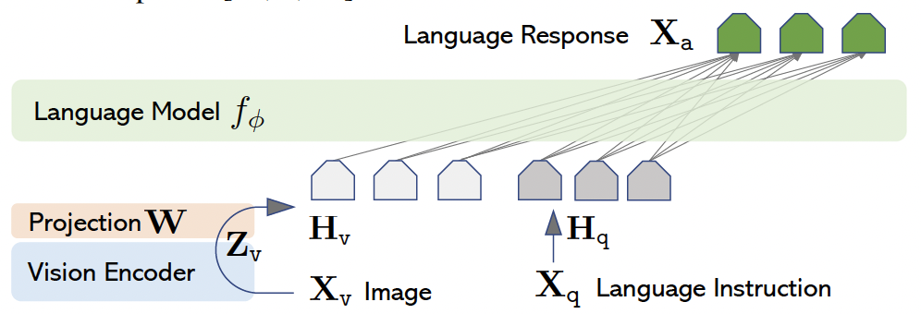
LLaVA
Solution
Data engineering: construct the first large image-text conversational dataset. Image (from COCO) is translated into a symbolic representation {caption, bounding boxes} for GPT-4 to understand the image and generate three types of questions (QA, description, complex reasoning).
Compose a larger model using light-weighted existing pre-trained visual and text encoders.
Image X_{v}
GPT-4 & question bank
X_{q}: Question X_{a}: Answer
{caption, bounding boxes}
Vicuna^{[1]}
Word embedding space
CLIP^{[2]}
Pre-training
+ Fine-tuning
on 8xA100 takes
less than 20 hrs
[1] Wei-Lin Chiang etc.. Vicuna: An open-source chatbot impressing gpt-4 with 90%* chatgpt quality
[2] Alec Radford, etc.Learning transferable visual models from natural language supervision. 2021

Slide 29
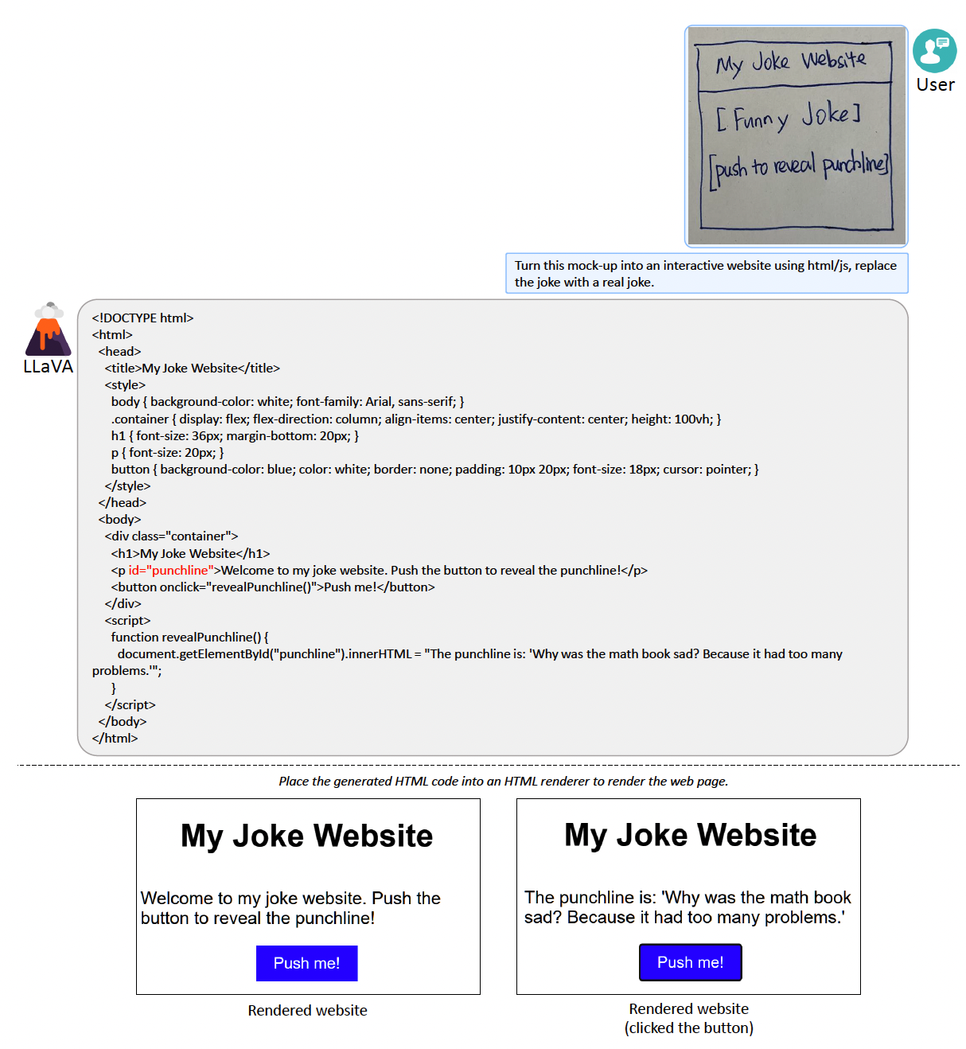
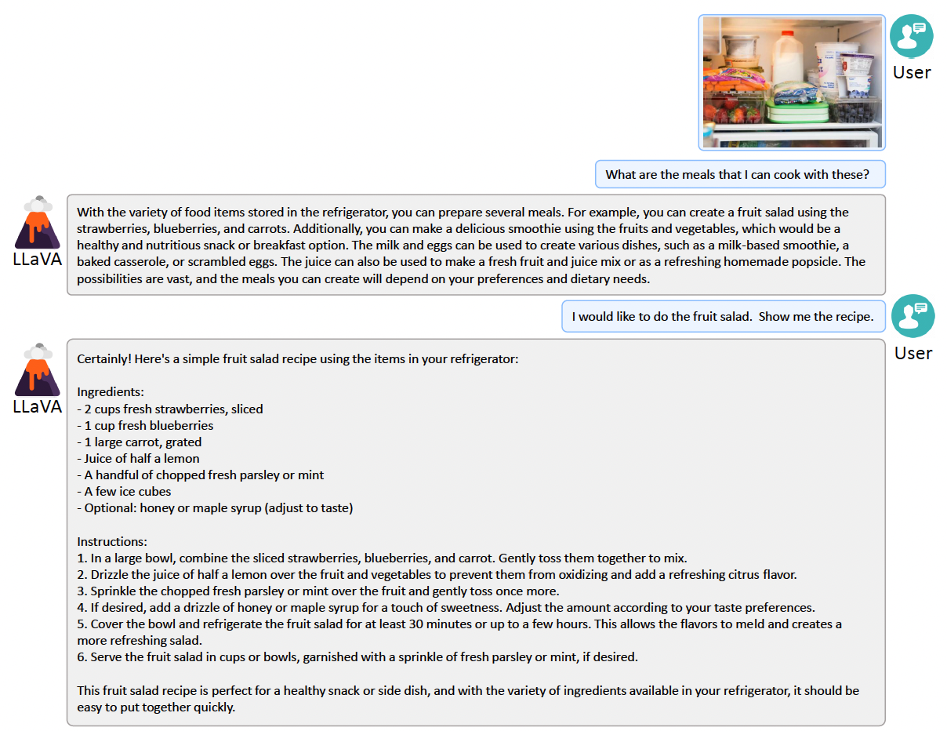
LLaVA: going beyond matching
(Amazing) Results
Coding
Perception and planning
Haotian Liu, etc. Visual Instruction Tuning. NeurIPS 2023

Slide 30
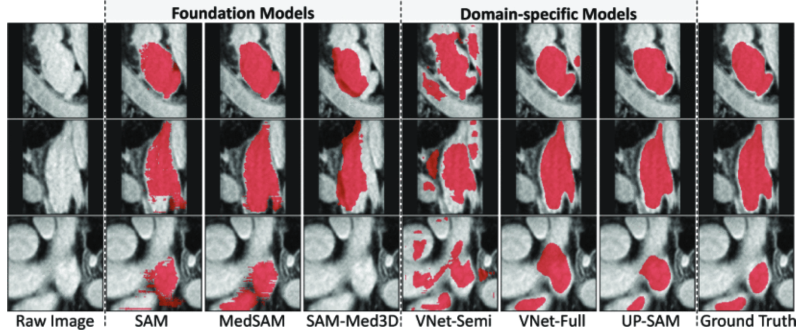
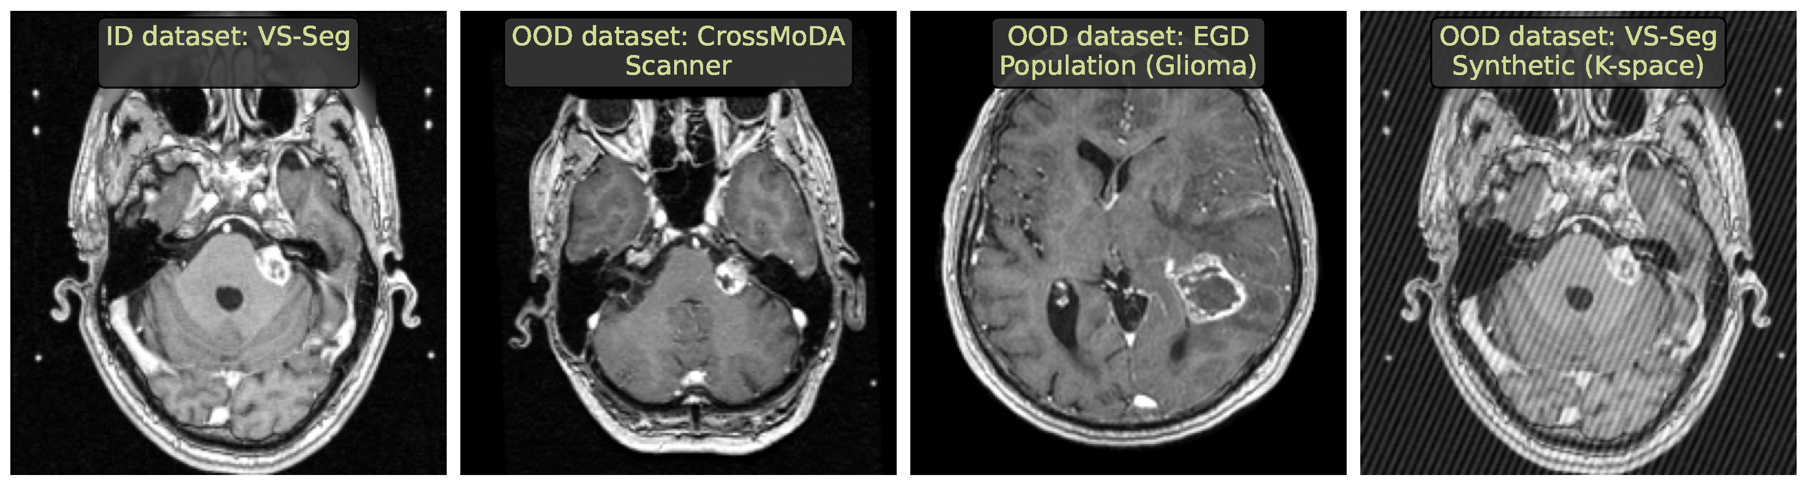
Responsibility issues
Uncertainty is not estimated well.
How can a model know it does not know?
Out-of-distribution data
UP-SAM: Uncertainty-Informed Adaptation of Segment Anything Model for Semi-Supervised Medical Image Segmentation. 2024 BIBM
Out-of-distribution detection in medical image analysis: A survey. 2024
Image Source:
Limitations of out-of-distribution detection in 3d medical image segmentation. Vasiliuk, Anton, et al. Journal of Imaging 9.9 (2023).

Slide 31
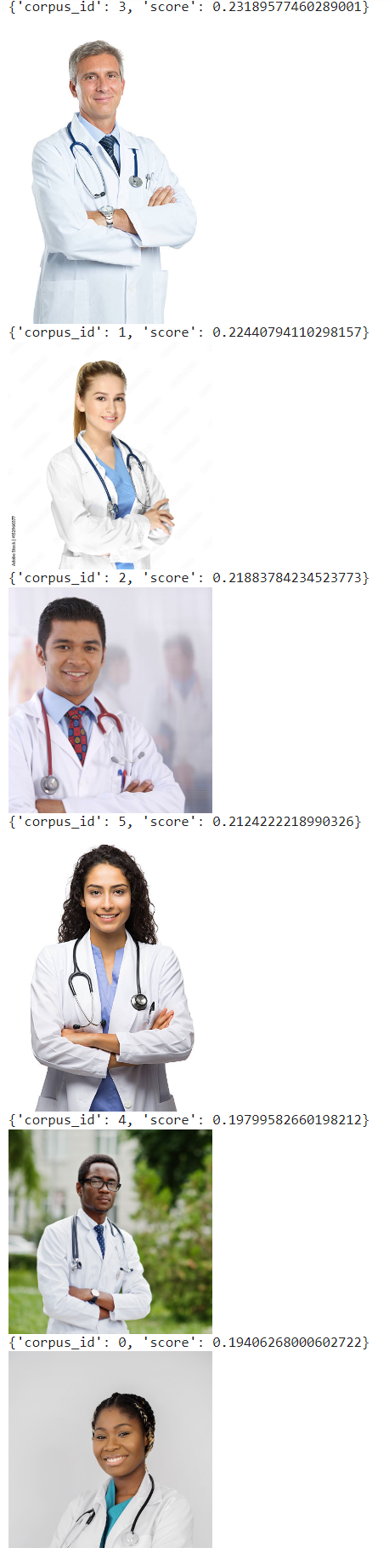

Responsibility issues
When querying images of “doctor”(left)
White male
White female
Hispanic male
Hispanic female
Black male
Black female
When querying images of “ceo” (right)
Image Source:
https://blog.gdeltproject.org/gender-race-bias-in-multimodal-image-embedding-models-a-case-study-of-openais-clip-how-white-men-are-doctors-ceos-not-black-women/

Slide 32


Responsibility issues
Source: Retrieve-then-compare mitigates visual hallucination in multi-modal large language models
https://www.alphaxiv.org/overview/2505.19474v1

